Slide 1
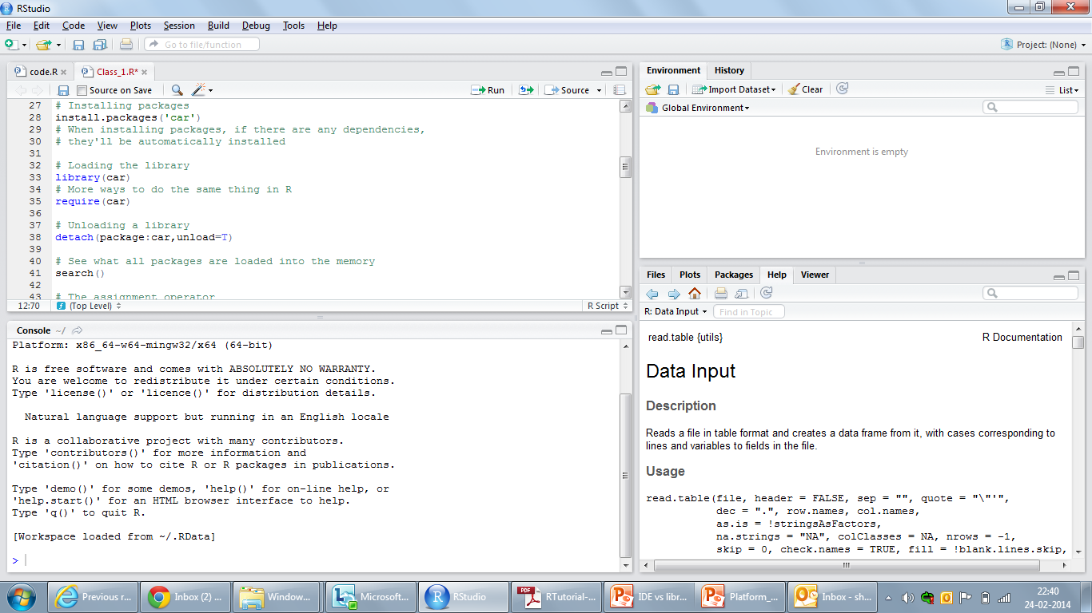
R Studio IDE
R Studio IDE- front end
(this is just a front end for nice display – it does not enhance R in anyway)
Can connect to any version
Of base R
Base R
(Open source – comes with a redistributable license)
R ver 2.15.3
R ver 3.0.1
R ver 3.0.2
. . . . . . . .
Continuous development
Package 1
Package 2
Package 3
. . . . . .
Package N
Extended functionality through CRAN packages

Slide 2
Revo R model
Revo R IDE
(v 5.0)
(has front end + other features*)
Revo R IDE
(v 6.X)
(has front end + other features*)
One Revo R edition is tied to a base R version
Base R
Base R
R ver 2.13.1
R ver 2.15.1
Each version supports only few packages
Package 1
Package 1
Package 1
. . . . . .
Package N
Extended functionality through CRAN packages

